Slide 1
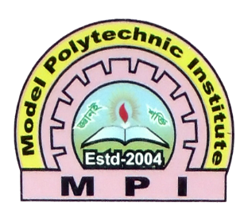
Welcome to Model Polytechnic Institute, Jashore

Slide 2
Menu
Home
Teachers
Lab
Results
Contact Us
Academic
About

Slide 3
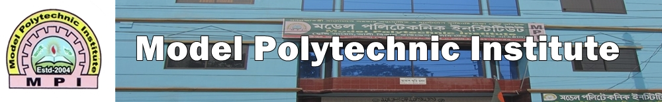
Home
Welcome to Model Polytechnic institute. We are providing one of the best education guide line in the technical education. This is our first web appearance and we are constantly trying to improve it. So be with us. We will right back.

Slide 4
Teachers
Md. Abbas Uddin
Abdullah Al Masud
Mominur Rohman
Debashis paul
Md. Rabiul Rafi
Shiblur Rohman
Nabil
Opu

Slide 5
lab
Network Lab
Hardware Lab
Software Lab
Electrical Lab
Electronics Lab
Textile Lab
Civil Lab
Mechanical Lab
Physics Lab
Chemistry Lab

Slide 6
results
Computer Result 2021
Civil Result 2021
Electrical Result 2021
Electronics Result 2021
Mechanical Result 2021
Textile Result 2021
Computer Result 2021
Civil Result 2021

Slide 7
Contact us
Teachers Name | Contact Number
Md. Abbas Uddin | 01999-923505
Abdullah Al Masud | 01999-923508
Mominur Rohman | 01999-923511
Debashis paul | 01999-923518
Md. Mazharul Islam | 01999-923513
Md. Rabiul Rafi | 01675-640787
Md. Salam | 01761-525200
Robiul Islam | 01999-923500
Shiblur Rohman | 01999-923517

Slide 8
Academic
Accreditation and Affiliation
MPI is fully accredited and affiliated by the Bangladesh Technical Education Board (BTEB), the only only national accreditation and affiliation authority in Bangladesh.
All examinations are conducted by BTEB along with all government Polytechnic Institutes.
Academic transcripts of all semesters are issued BTEB
Diploma-in-Engineering Certificates are awarded by BTEB for all government and private polytechnic institutes with same credential.

Slide 9
About
Model Polytechnic Institute is a Government approved technical education institute and maintained under the rules of technical Board of Bangladesh.
This institutions is a part and affiliated with the ” Munshi Sayed Ali Bishwash Foundation Ltd.” Our promise is to develop our students in such a way that they will be the assets of twenty first century and will take steps in the development of Digital Bangladesh.
Why Choose Us?
Academic activities are conducted by more than hundred highly qualified, efficient and experienced teachers what other Private Polytechnics do not have.
Computer labs are fully air cooled providing one computer for every student.
ICT labs are facilitated with high speed broad band internet.
Multimedia, OHP and other modern instructional aids are used in conducting classes.

Slide 10
THANK YOU

